Slide 1
Playing with Numbers (08.07.20)
Grade 8 – Chapter 5

Slide 2
Letters for digits
Here we have puzzles in which letters take the place of digits in an arithmetic ‘sum’, and the problem is to find out which letter represents which digit. For example, if :
4 Q 1
3 8 Q
——— (+)
8 0 3
———
Then the value of Q will be 2 as 2 is the only digit which results in 3 when 1 is added to it. Also, 2+8 =10, 1 as carry and then 1+4+3 =8. So, the value of Q is 2.

Slide 3
Example 1
Solve for Q:
Solution:
From the addition above, we can say Q + 3 = 1. For this, Q must be equal to 8. So, the puzzle becomes:

Slide 4
Example 2
Find the digits A, B and C.

Slide 5
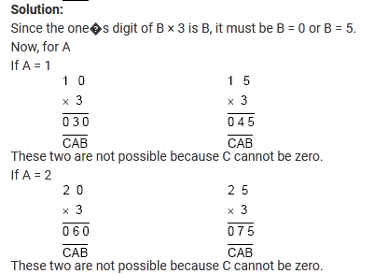

Slide 6
